Slide 1

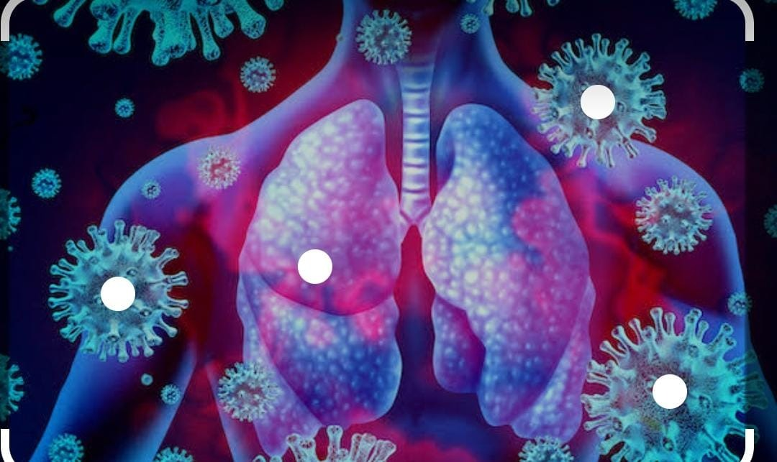
ADVANCES IN DIABETES MANAGEMENT DURING COVID-19
Project Review
Project guide - Dr. A. Ramesh
Professor and Principal of VIPER
Department of Pharmacology
Presenting by
M.Sneha (18DH1R0056)
N.Manisha (18DH1R0064)
P.Srujana (18DH1R0076)
Vishnu Institute of Pharmaceutical Education and Research

Slide 2
INTRODUCTION
Globally, COVID-19 has grown to be a significant problem, especially in emerging and heavily populated nations like India. The highly contagious COVID-19 is spread by respiratory droplets from infected individuals. Among the many comorbidities linked to COVID-19, diabetes mellitus, hypertension, and cardiovascular disease are quite common. COVID-19 has been found to be related with high blood glucose levels, particularly in those who have type 2 diabetes (T2DM).
Diabetes mellitus has been linked to an increased risk of developing a variety of infections, according to several research. The severity of the condition is significantly exacerbated by the dysregulated immunoresponse seen in diabetes individuals. One of the comorbidities associated with mortality and morbidity in COVID-19 patients is diabetes mellitus. Diabetes patients may be more susceptible to more severe COVID-19 symptoms due to chronic diseases such obesity, cardiovascular disease, and hypertension, as well as altered ACE2 expression, dysregulated immune response, and endothelial dysfunction.
Therefore, it is crucial to research particular COVID-19 features in diabetic patients and treat these comorbidities in addition to the COVID-19 infection, especially in elderly people who are already dealing with significant and life-threatening diseases.

Slide 3
AIMS
To evaluate the relation between COVID-19 and Diabetes and advances in treating the diabetes.
OBJECTIVES
To study the relationship of diabetes during COVID 19.
Risks involved during COVID 19 for diabetic patients.
To evaluate the comorbidities associated with COVID-19 in Diabetic patients.
Management of Diabetes during COVID-19.
To know the advances in treating methods.

Slide 4
REVIEW OF LITERATURE
A literature review was done within databases of Scopus, PubMed, Science direct, and Web of science. Observational reviews, case-report, and case-series studies that assessed the diabetes in COVID-19 patients, were known.
Some studies suggest that there were no significant differences in symptoms between patients who suffered from both diabetes and COVID-19 and those who only suffered COVID-19.
It was known from review article that mortality during COVID 19 in association with diabetes was 14.5%. These clients have poor ARDS prognosis, severe symptoms, and the death rate is higher among COVID-19 patients.

Slide 5
METHODOLOGY
A literature review was carried out to search for articles in PubMed and Google Scholar databases till 20 June 2022.
We also retrieved some of the relevant cross references from their research results.
Further to it ,we accessed the currently available scientific literature and recommendations in the WHO and United States Centers for Disease Control and Prevention (CDC) websites.
We have performed comparative studies and we found that:
Out comes in patients with COVID 19 and DM
Treating non infected patients with diabetes
Treating patients with DM and COVID 19

Slide 6
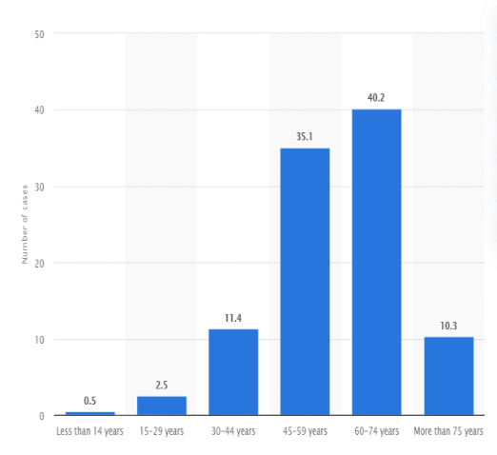
DEMOGRAPHIC STUDY
Even though all age groups have been affected by COVID-19, the median age appears to be around 47–59 years, and usually higher among severe cases and non-survivors. No specific gender bias seems to exist for the contamination with the virus, but men tend to have a higher propensity of the cases.
Fewer cases have been identified among children and infants.
In a large Chinese report including 72,314 patients, only 2% of those infected were younger than 20 years old.
The clinical spectrum of COVID-19 can be very heterogeneous. Most adults and children present mild flu-like symptoms, but some may rapidly develop acute respiratory distress syndrome (ARDS), respiratory failure, arrhythmias , acute cardiac injury, shock, multiple organ failure and death.

Slide 7
*You may need to take more than one of these drugs. Some people with type 2 diabetes also take insulin.
MEDICATIONS
Types of drug | How they work | Example(s)
Alpha-glucosidase inhibitors | Slow your body’s breakdown of sugars and starchy foods | Acarbose (Precose) and miglitol (Glyset)
Biguanides | Reduce the amount of glucose your liver makes | Metformin (Glucophage)
DPP-4 inhibitors | Improve your blood sugar without making it drop too low | Linagliptin (Tradjenta), saxagliptin (Onglyza), and sitagliptin (Januvia)
Glucagon-like peptides | Change the way your body produces insulin | Dulaglutide (Trulicity), exenatide (Byetta), and liraglutide (Victoza)
Meglitinides | Stimulate your pancreas to release more insulin | Nateglinide (Starlix) and repaglinide (Prandin)
SGLT2 inhibitors | Release more glucose into the urine | Canagliflozin (Invokana) and dapagliflozin (Farxiga)
Sulfonylureas | Stimulate your pancreas to release more insulin | Glyburide(DiaBeta, Glynase), glipizide (Glucotrol), and glimepiride (Amaryl)
Thiazolidinediones | Help insulin work better | Pioglitazone (Actos) and rosiglitazone (Avandia)

Slide 8
INDICATIONS
Study | Metformin | SGLT2 inhibitors | GLP-1 RA | DPP-4 inhibitors | Insulin
~ 3 million patients with type 2 diabetes, including ~ 13,500 who died due to Covid-19, in a UK nationwide population cohort | Covid-19 mortality less likely vs no metformin | Covid-19 mortality less likely vs no SGLT2i | No significant difference in Covid-19 mortality vs no GLP-1 RA | Covid-19 mortality more likely vs no DPP-4i | Covid-19 mortality more likely vs no insulin
~ 12,500 patients with a positive Covid-19 test in a US longitudinal cohort (N3C) | Not investigated | Lower rates of 60-day mortality, ER visits and hospitalization vs DPP-4i | Lower rates of 60-day mortality, ER visits and hospitalization vs DPP-4i | 60-day mortality, ER visits and hospitalization more likely vs SGLT2i or GLP-1 RA | Not investigated
1970 people on GLP-1 RA, SGLT2i or DPP-4i in nationwide registries in Denmark who were infected with Covid-19 | Not investigated | No significant differences to GLP-1 RA or DPP-4i, but a trend towards reduced 30-day mortality vs DPP-4i | No significant difference to SGLT2i | A non-significant trend towards increased 30-day mortality vs SGLT2i | Not investigated
2666 patients with type 2 diabetes in a nationwide Covid-19 registry in Spain (SEMI-COVID-19) | No significant differences after propensity matching | Not investigated | Not investigated | No significant differences after propensity matching | No significant differences after propensity matching
2796 patients with diabetes hospitalized for Covid-19 in a nationwide study in France (CORONADO) | 28-day mortality less likely vs insulin or no metformin | Not investigated | Not investigated | Neutral effect vs patients not on DPP-4i | 28-day mortality more likely vs metformin

Slide 9
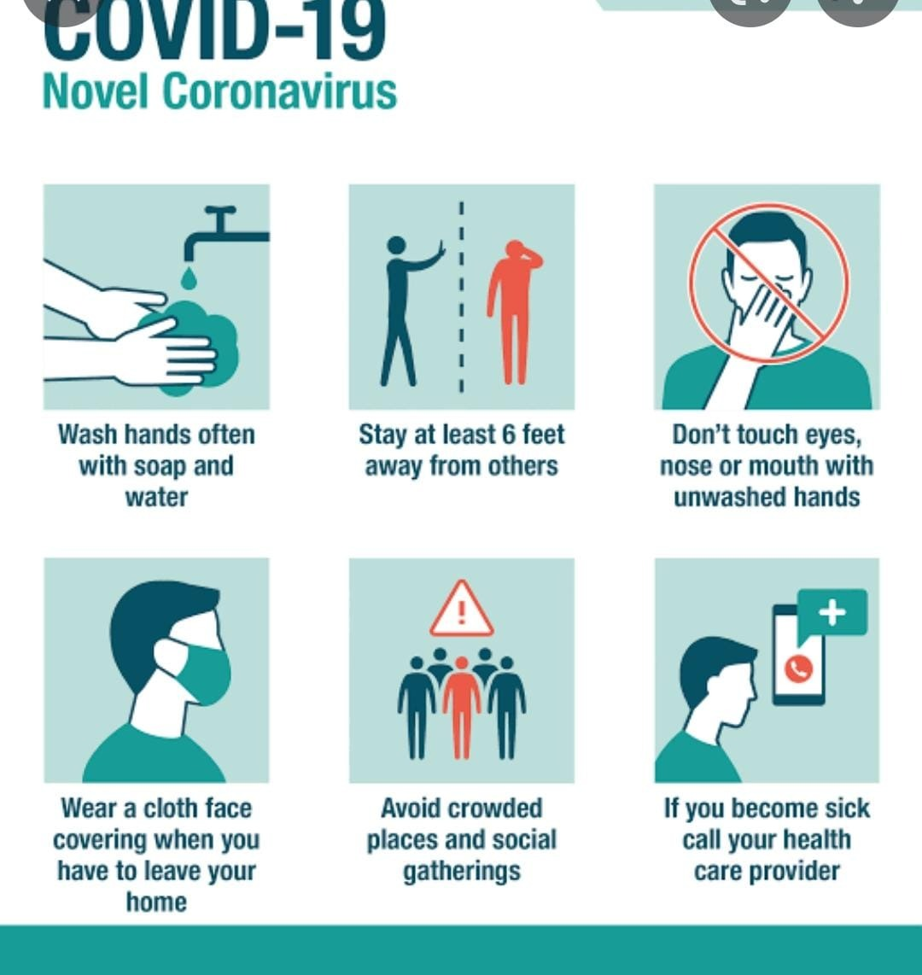
4th Wave
After the supposed third wave of the SARsCoV2 pandemic - said to have been largely driven by the Omicron variant - thankfully failed to beat the scary statistics notched by the second wave, most Indians have begun to assume that the fourth wave as predicted by the IIT experts is not coming. But if that would spread then it will be disastrous assumption to ride on as global figures show.
As the fourth COVID wave is predicted to hit India in June, a virologist on March 19 said that there is no scientific, epidemiological, virological reason to predict the wave and even the probability is extremely low.
India Report says 14,506 cases have been registered, out of which 30 deaths have been occurred within 24 hours.
We can say the probability is extremely low but we've to be vigilant."
PREVENTION
Maintaining hygiene
Practicing social distancing
Managing a healthier life style
Utilizing feasible therapeutics and vaccines ( Chemoprophylaxis, Vaccines)
Due to infection immune system is compromised, it's advised to stay hydrated and drinking plenty of fluids, practice meditation and breathing exercises, consume healthy food, have adequate sleep, avoid alcohol and smoking.

Slide 10
RESULTS AND DISCUSSION
COVID-19 disease is a novel respiratory illness that spreads across the world and to date it infected above 2.9 million people and resulted in around 202,000 deaths.
The cumulative prevalence of diabetes in COVID-19 patients was 14.5%.
The overall prevalence of diabetes was 54.4% in MERS and for H1N1 influenza it was 14.6%
In international diabetes federation (IDF) statement reported that symptoms in diabetes patients were not different with other COVID-19 patients, however the severity was more among diabetic patients.
Various studies reported that patients with diabetes are more likely than healthy people to develop COVID-19 disease and complications such as ARDS and even death.
It is well documented that diabetes increases the severity of the COVID-19 disease. However, the pathology is still unclear. Understanding the interaction between diabetes and COVID-19 could open a window for therapeutic measures, but there is a paucity of data on this issue.

Slide 11
CONCLUSION
Increase in morbidity and mortality rate is found to be high in diabetic patients coexisting with COVID-19 when compared with healthy individuals.
Dapagliflozin is the alternate medicine that has been introduced to use instead of Metformin in patients with association of diabetes and COVID-19.
Regular monitoring of Glycemic levels, special care and preventive measures should be followed.

Slide 12
REFERENCES
Centers for Disease Control and Prevention. National diabetes statistics report, Centers for Disease Control and Prevention website, Updated July, 18 2017, accessed August 1, 2017.
Medically reviewed by Marina Basina, M.D., written by Stephanie Watson, Health Line Website, updated on February 26, 2020.
Medically reviewed by Soo Rhee, MD, Written by Kathryn Watson, Health Line Website, Updated on April 13, 2022.
Chidiebere V. Ugwueze, Dubai Diabetes Endocrinol J COVID-19 and Diabetes Mellitus, 2020; 26:69–77.
The Lancet team, Prof Ann V Schwartz, PhD, Jye-Yu C Backlund, MPH, Prof Ian H de Boer, MD, Mishaela R Rubin, MD, Annette Barnie, RN, Kaleigh Farrell, BA, Victoria R Trapani, MPH, Naina Sinha Gregory, MD, Amisha Wallia, MD, Ionut Bebu, PhD, Prof John M Lachin, PhD, Barbara H Braffett, PhD, Prof Rose Gubitosi-Klug, MD, the DCCT/EDIC Research Group, Published online April 23, 2020, VOLUME 8, ISSUE 6, P546-550, JUNE 01, 2020.
RimeshPal, Sanjay K.Bhadada, Diabetes & Metabolic Syndrome: Clinical Research & Reviews, Volume 14, Issue 4, July–August 2020.
Czupryniak, L., Dicker, D., Lehmann, R. et al. The management of type 2 diabetes before, during and after Covid-19 infection: what is the evidence? Cardiovasc Diabetol 20, 198 (2021).
Cadiovascular Diabetology, Cadiovascular Diabetology website, ISSN: 1475-2840.

Slide 13
THANK YOU

